Slide 1

Course Name: Hardware Security
Faculty Name: Prof Debdeep Mukhopadhyay
Department : Computer Science and Engineering
Topic
Lecture 31: Power Analysis-VII

Slide 2

Concepts Covered:
Correlation Power Attacks (CPA)
Implementing CPA on Simulated Traces

Slide 3
Correlation Power Attack (CPA)
Like DoM based DPA, CPA also relies on targeting an intermediate computation, typically the input or output of an S-Box.
These input values are computed from a known value, say the ciphertext and a portion of the key, which is guessed.
The power model is then subsequently applied to develop a hypothetical power trace of the device for a given input to the cipher.
These hypothetical power values are then stored in a matrix for several inputs and can be indexed by the known value of the ciphertext and the guessed key byte.
This matrix is denoted as H, the hypothetical power matrix.

Slide 4
Correlation Power Attack (CPA)-Contd.
The attacker also observes the actual power traces, and stores them in a matrix for several inputs.
The actual power values can be indexed by the known value of the ciphertext and the time instance when the power value was observed.
This matrix is denoted by T, the real power matrix.
It may be observed that one of the columns of the matrix H corresponds to the correct key k*.
CPA tries to compute the similarity between the columns of the matrix H and the columns of the matrix T, to distinguish k* from rest: similarity computed by Pearson’s Correlation, usually.

Slide 5
Computing Correlation Coefficient for Simulated Power Traces for AES
Like before, we simulate the power profile for the iterative AES, this time by using Hamming Distance power model applied on the state registers updated after each round.
The real power matrix is stored in the array trace[NSample][NPoint]
NSample: Number of Power Traces acquired
NPoint: Time instances for which the power values are observed. Here NPoint is 12.

Slide 6
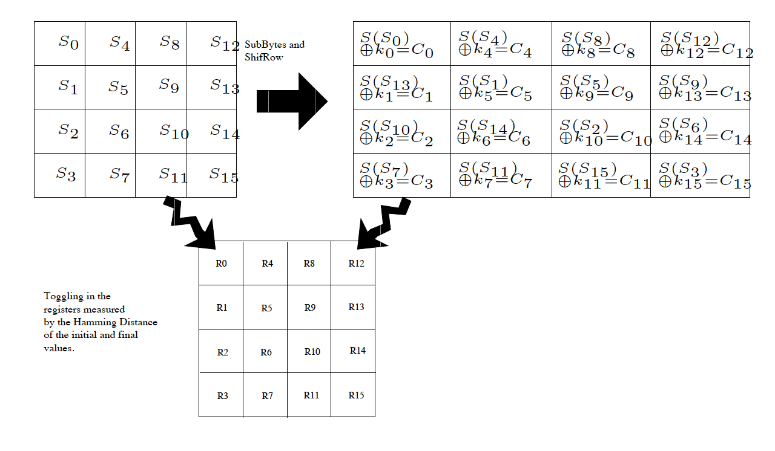
Calculating the Hypothetical Power
R0 | R1 | R2 | R3 | R4 | R5 | R6 | R7
S0,C0 | S1,C1 | S2,C2 | S3,C3 | S4,C4 | S5,C5 | S6,C6 | S7,C7
C0,K0 | C5,K5 | C10,K10 | C15,K15 | C4,K4 | C9,K9 | C14,K14 | C3,K3
R8 | R9 | R10 | R11 | R12 | R13 | R14 | R15
S8,C8 | S9,C9 | S10,C10 | S11,C11 | S12,C12 | S13,C13 | S14,C14 | S15,C15
C8,K8 | C13,K13 | C2,K2 | C7,K7 | C12,K12 | C1,K1 | C6,K6 | C11,K11

Slide 7
Computing the Correlation Matrix
Actual Power values for all the NSample encryptions are stored in the array trace[NSample][NPoint].
However, reflect as we are calculating hypothetical power using HD, the trick which we applied before for storing the traces compactly will not work.
Attacker first scans each column of this array and computes the average, and stores in meanTrace[NPoint].
Likewise, the hypothetical power is stored in the array hPower[NSample][NKey].
Attacker scans each column and stores in the array meanH[NKey]

Slide 8

Correlation Matrix
NPoint
NSample
NSample
NKey
Hypothetical Power matrix H
Real Power matrix T
NKey
NPoint

Slide 9
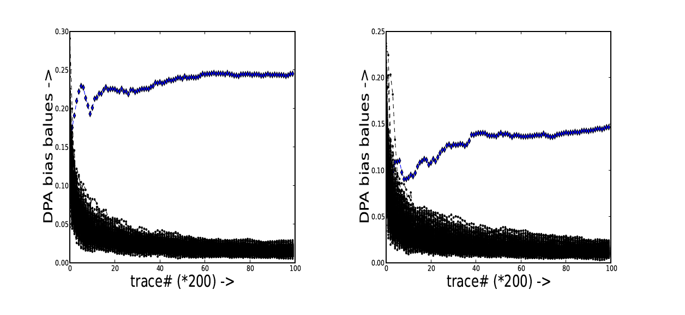
Experimental Results on Simulated Traces
CPA on first key byte of 10th Round of AES
Power is Simulated by Hamming Distance of the Registers after each Round
Power is Simulated by Hamming Distance of the Registers after each Round, with superimposed Gaussian Noise.

Slide 10
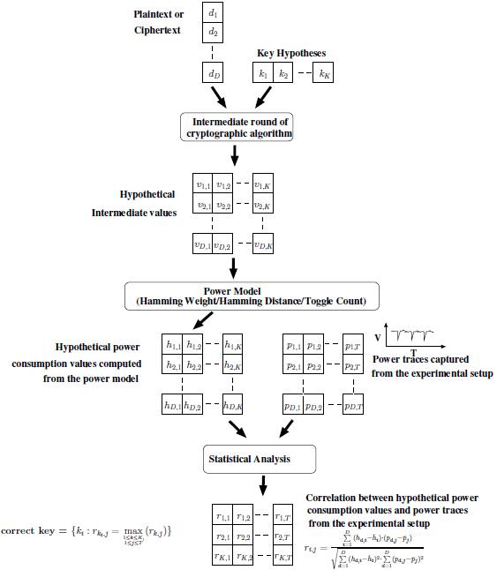
Summary of Correlation Power Analysis

Slide 11

D. Stinson, Cryptography: Theory and Practice, Chapman & Hall/CRC
Lawrence C. Washington, Elliptic Curves: Number Theory and Cryptography, Chapman & Hall/CRC
Jeffrey Hoffstein, Jill Pipher, Joseph H. Silverman, An Introduction to Mathematical Cryptography, Springer.

Slide 12
Conclusion:
DoM based DPA can be programmed in a systematic fashion.
One can learn the technique on simulated power traces, modeled by Hamming Weight or Hamming Distance Models.
Stochastic Modeling of leakage can help to improve accuracy, but requires profiling.
CPA is an improved method of DPA and can also be systematically programmed.

Slide 13


